Slide 1





Natural Language Processing

Slide 2
Overview
Motivation & Applications
Context-Free Grammars
Part of Speech Tagging (HMM)
N-grams
Morphisms
Recap on Neural Networks
Word Embeddings & Vector Representation
Demonstration
Notes:
The first half of the lecture will be mostly referencing:
“Speech and Language Processing. An Introduction to Natural Language Processing, Computational Linguistics, and Speech Recognition.” by Daniel Jurafsky & James H. Martin

Slide 3
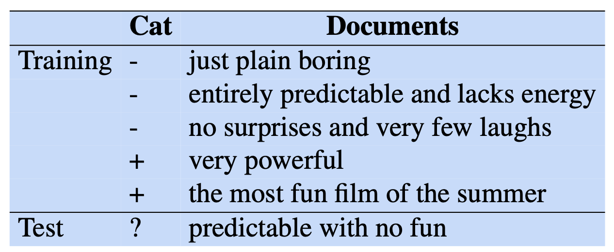
Applications #1: Sentiment Analysis
Speech and Language Processing by Daniel Jurafsky & James H. Martin

Slide 4
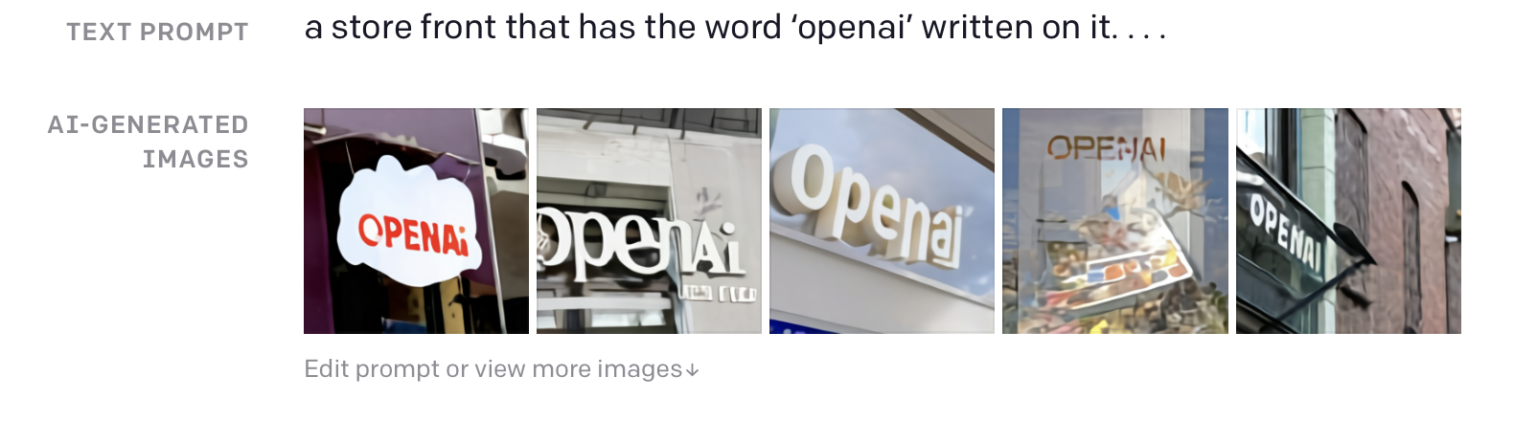
Applications #2: Text-to-image Generation
https://openai.com/blog/dall-e/

Slide 5
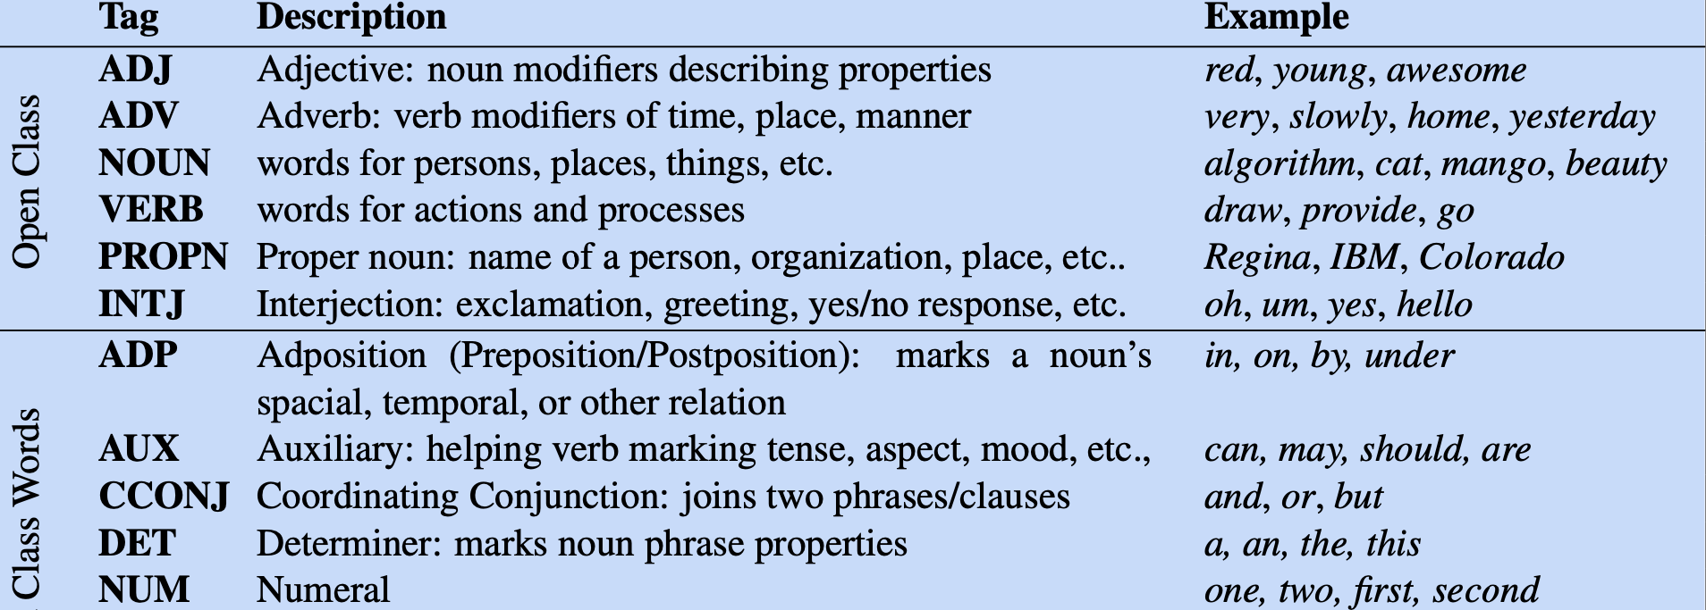
Part-of-speech terms in English
https://aclanthology.org/L16-1262.pdf
Notes:
”Parts of speech fall into two broad categories: closed class and open class. Closed classes are those with relatively fixed membership, such as prepositions— new prepositions are rarely coined. By contrast, nouns and verbs are open classes— new nouns and verbs like iPhone or to fax are continually being created or borrowed. Closed class words are generally function words like of, it, and, or you, which tend to be very short, occur frequently, and often have structuring uses in grammar.”
Lexical categories are verbs, nouns, adjectives, … the rest of the tags.
Syntactic categories are combinations of lexical categories, like Noun Phrase (NP), Verb Phrase (VP).
A Phrase Structures is a combination of Syntactic categories into trees, resulting in nested phrases.

Slide 6
Syntactic Parsing simplified
Phrase Structure
Verb Phrase
Bottom-up approach
Noun Phrase
Noun Phrase
Personal Pronoun
Verb
Noun
Noun
We love Data Science.
Notes:
The syntactic parsing is a ”process of uncovering the phrase structure of a strings of words, according to a grammar”. It could be performed in top-down or bottom-up approaches.

Slide 7
Context-free grammars: Formal definition
A CFG is a defined by G = (N, ∑, R, S), where:
N is the set of non-terminal symbols
∑ is the set of terminal symbols which do not belong to N.
R is the set of production rules of the form A⇾𝛽 such that:
A∈N
𝛽 ∈ (N ∪ ∑)
S is the start symbol & S ∈ N
Notes:
“A context-free grammar consists of a set of rules or productions, each of which expresses the ways that symbols of the language can be grouped and ordered together, and a lexicon of words and symbols.”

Slide 8
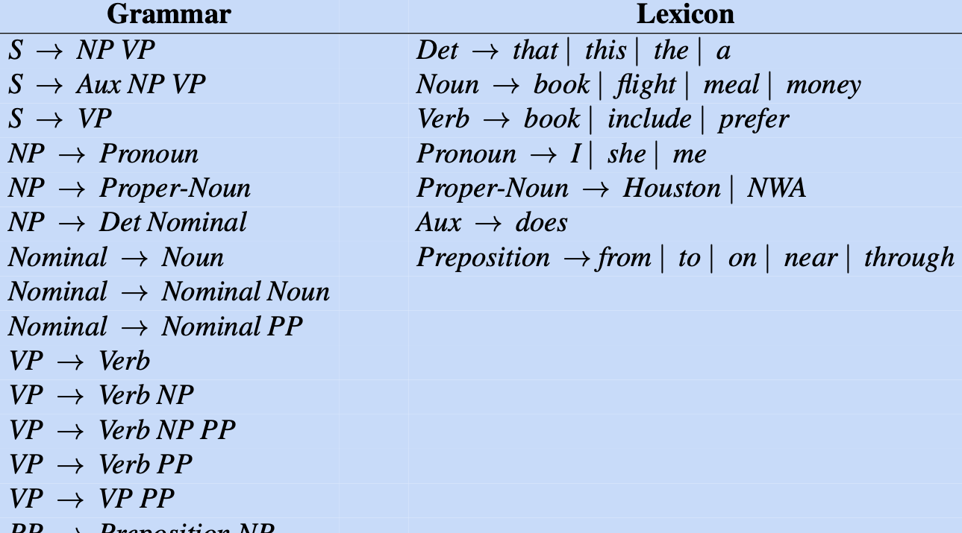
Context-free grammars: Example
Speech and Language Processing by Daniel Jurafsky & James H. Martin
Notes:
A grammar defines the derivations of the parse tree, whereas the lexicon is comprised of the totality of possible words that the Part-of-speech tag includes.

Slide 9
Context-free grammars: Recursion
Left-recursion
CatLanguage⇾ CatLanguage meow
Right-recursion
CatLanguage ⇾ meow CatLanguage
where CatLanguage is a non-terminal symbol & meow is a terminal one.
Notes:
All recursive operations require a defined terminal case, otherwise the whole program will take too much resources and eventually crash.

Slide 10
Syntactic Parsing: Revisited
Phrase Structure
Simplified version
Verb Phrase
Noun Phrase
Noun Phrase
Personal Pronoun
Verb
Noun
Noun
We love Data Science.
Notes:
The syntactic parsing is a ”process of uncovering the phrase structure of a strings of words, according to a grammar”. It could be performed in top-down or bottom-up approaches.

Slide 11
left-recursive Syntactic Parsing
Phrase Structure
Verb Phrase
Noun Phrase
Verb Phrase
Noun Phrase
Noun Phrase
Noun
Personal Pronoun
Verb
Noun
We love Data Science.

Slide 12
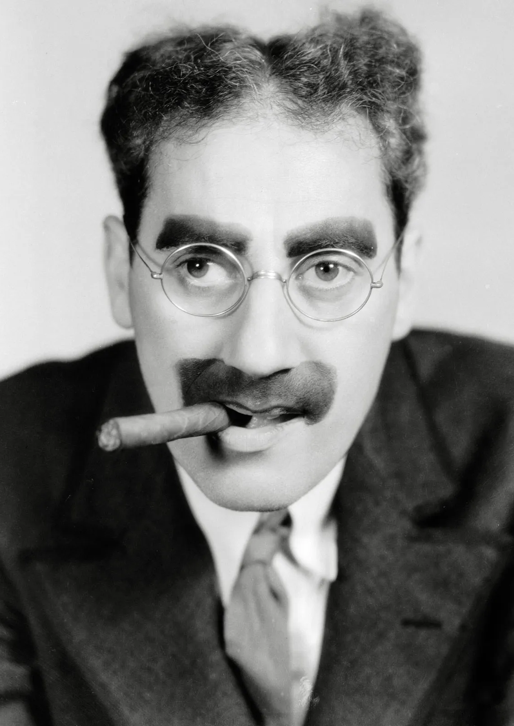
Ambiguity
Groucho Marx (US comedian):
”I shot an elephant in my pajamas. “
Definition:
”Structural ambiguity occurs when the grammar can assign more than one parse to a sentence. “
https://www.britannica.com/biography/Groucho-Marx

Slide 13
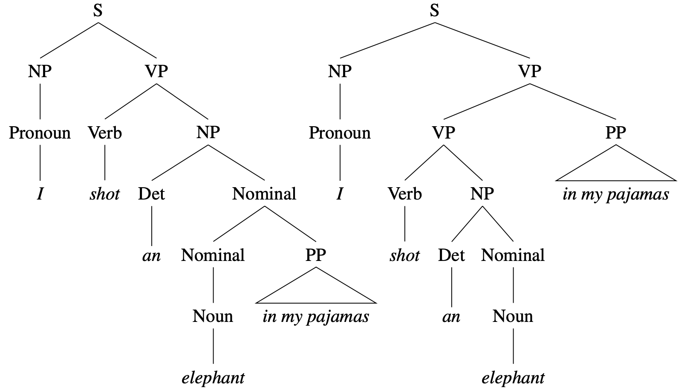
part-of-speech disambiguation
Cocke-Kasami-Younger (CKY):
”A standard dynamic programming approach to syntactic parsing."
Speech and Language Processing by Daniel Jurafsky & James H. Martin
Notes:
Structural ambiguity has many forms:
attachment ambiguity - The PP-example from slide, or as well:
We saw the Eiffel Tower flying to Paris.
coordination ambiguity – phrases can be conjoined by a conjunction like and.
“old men and women”
To tackle the problem of ambiguity we make use of Cocke-Kasami-Younger (CKY) algorithm, which is a ”standard dynamic programming approach to syntactic parsing".
“The vanilla CKY algorithm returns an efficient representation of the set of parse trees for a sentence but doesn’t tell us which parse tree is the right one. For that, we need to augment CKY with scores for each possible constituent.”
“Dynamic programming provides a powerful framework for addressing the problems caused by ambiguity in grammars. Recall that a dynamic programming approach systematically fills in a table of solutions to sub-problems. The complete table has the solution to all the sub-problems needed to solve the problem. In the case of syntactic parsing, these sub-problems represent parse trees for all the constituents detected in the input.“

Slide 14
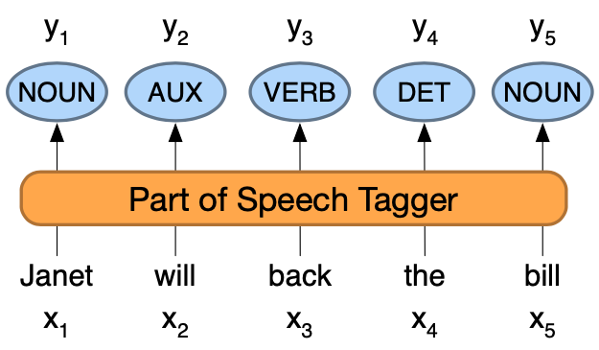
part-of-speech tagging
Speech and Language Processing by Daniel Jurafsky & James H. Martin
Notes:
“ Part-of-speech tagging is the process of assigning a part-of-speech to each word in a text. “
“ Tagging is a disambiguation task; words are ambiguous —have more than one possible part-of-speech—and the goal is to find the correct tag for the situation. For example, book can be a verb (book that flight) or a noun (hand me that book). That can be a determiner (Does that flight serve dinner) or a complementizer (I thought that your flight was earlier). The goal of POS-tagging is to resolve these ambiguities, choosing the proper tag for the context. ”
POS-tagging is used for:
question answering;
stance detection;
Information Extraction;
POS-tagging is an important aspect of parsing.

Slide 15
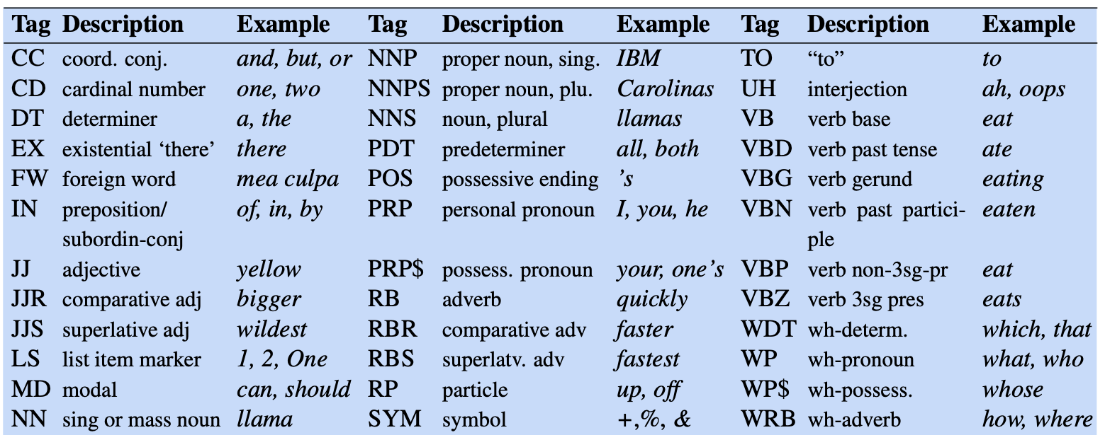
The Penn Treebank tag-set
Speech and Language Processing by Daniel Jurafsky & James H. Martin

Slide 16
Ambiguous Tagging
Earnings growth took a back/JJ seat.
A small building in the back/NN.
A clear majority of senators back/VBP the bill Dave began to back/VB.
Toward the door enable the country to buy back/RP debt.
I was twenty-one back/RB then.

Slide 17
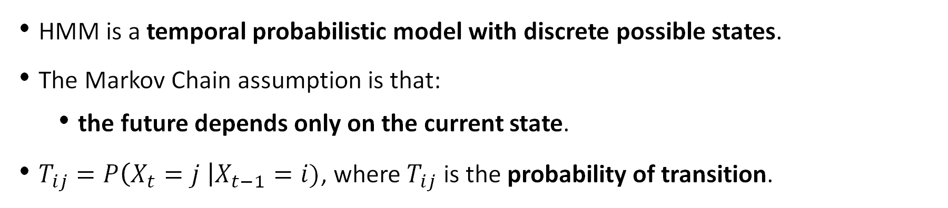
Hidden markov Model (HMM): Assumption
HMM is a temporal probabilistic model with discrete possible states.
The Markov Chain assumption is that:
the future depends only on the current state.
$T_{ij}=P\left(X_{t}=j \right|X_{t−1}=i)$, where $T_{ij}$ is the probability of transition.
Notes:
” The HMM is based on augmenting the Markov chain. A Markov chain is a model that tells us something about the probabilities of sequences of random variables, states, each of which can take on values from some set. These sets can be words, or tags, or symbols representing anything, for example the weather. A Markov chain makes a very strong assumption that if we want to predict the future in the sequence, all that matters is the current state. All the states before the current state have no im- pact on the future except via the current state. It’s as if to predict tomorrow’s weather you could examine today’s weather, but you weren’t allowed to look at yesterday’s weather. "

Slide 18
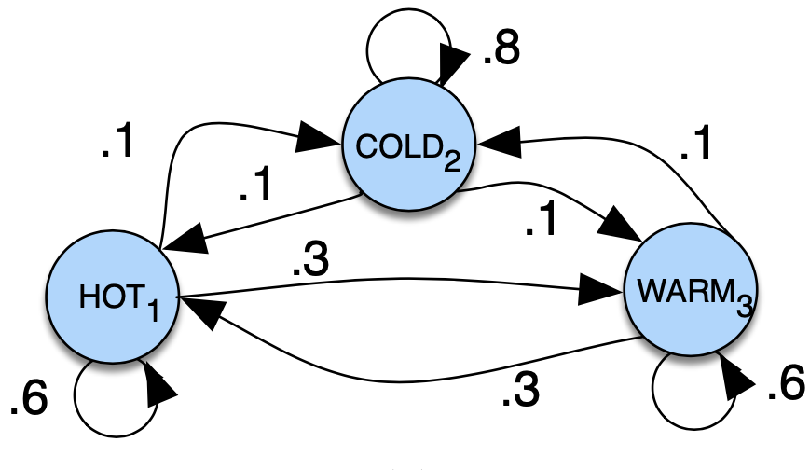
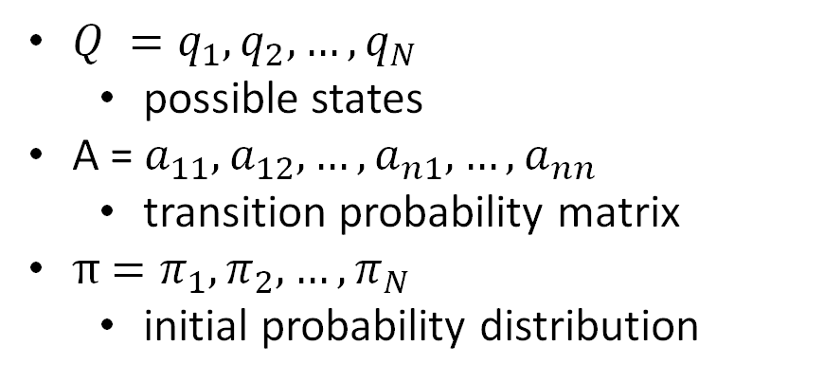
Markov Chain: Definition
$Q =q_{1},q_{2}, …,q_{N}$
possible states
A = $a_{11},a_{12},…,a_{n1},…{, a}_{nn}$
transition probability matrix
π $=π_{1},π_{2}, …,π_{N}$
initial probability distribution
 | Hot | Warm | Cold
Hot | 0.6 | 0.3 | 0.1
Warm | 0.3 | 0.6 | 0.1
Cold | 0.1 | 0.1 | 0.8
Speech and Language Processing by Daniel Jurafsky & James H. Martin

Slide 19
Markov chain: Example
P(hot, hot, cold)=
π(hot) P(hot|hot) P(cold|hot)
 | Hot | Warm | Cold
Hot | 0.6 | 0.3 | 0.1
Warm | 0.3 | 0.6 | 0.1
Cold | 0.1 | 0.1 | 0.8
Speech and Language Processing by Daniel Jurafsky & James H. Martin

Slide 20
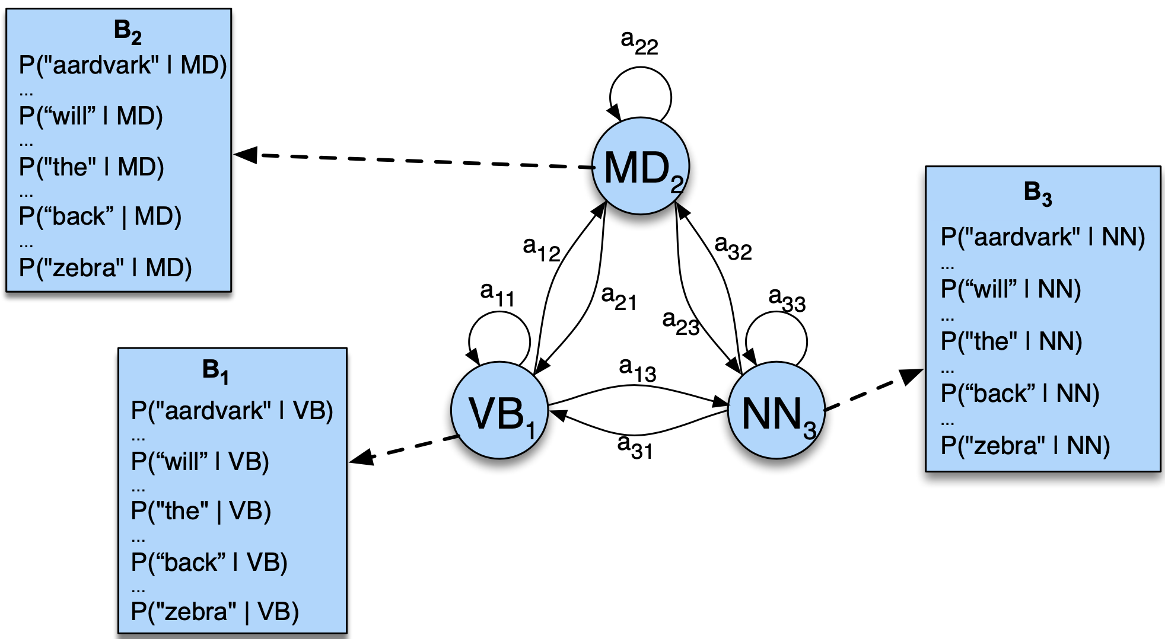
Hidden markov Model: POS-Tagging
Speech and Language Processing by Daniel Jurafsky & James H. Martin

Slide 21
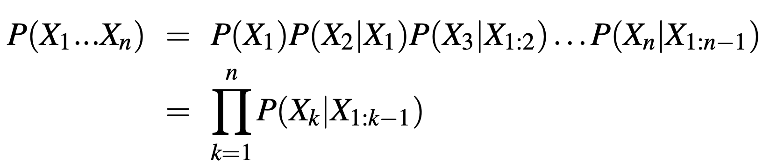
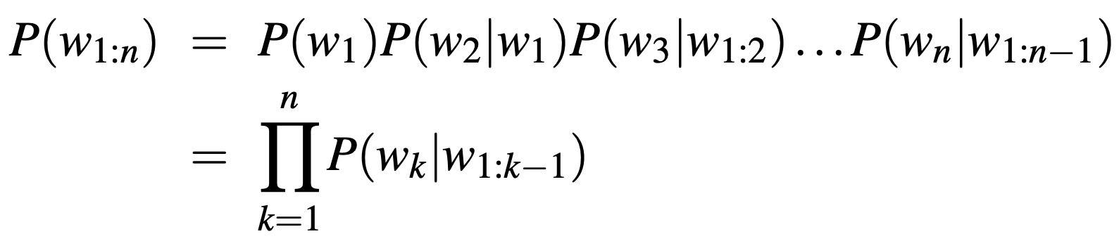
Joint Probability
Notes:
Evaluating the probability of an entire word sequence could be done with the joint probability, but it would not capture the creativity of language & would rely on counting occurrences of sequences of words.

Slide 22
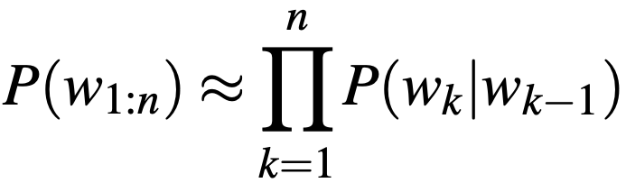
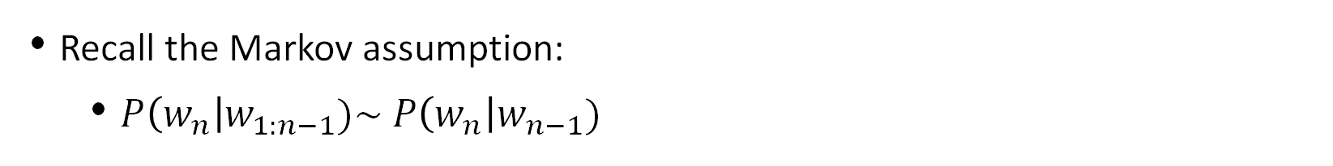
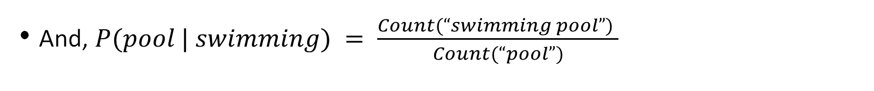
Bigrams
Recall the Markov assumption:
$P\left(w_{n}\right|w_{1:n−1})\sim P\left(w_{n}\right|w_{n−1})$
P(pool | ”I went to the swimming pool”) = P(pool | swimming)
And, $P(pool | swimming) = \frac{Count(“swimming pool”) }{Count(“pool”)}$
Then, approximating the joint probability comes down to:
Notes:
Instead of using the joint probability, approximate the probability of a word given all the previous words by using conditional probability of the preceding word.

Slide 23
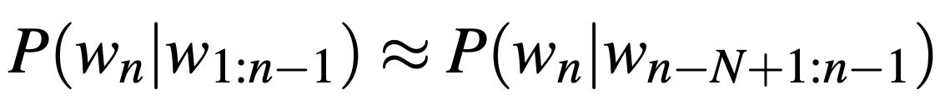
N-grams
Markov assumption:
“I went to the swimming pool”
unigram = [“I”, “went”, “to”, … ]
bigram = [”I went”, “went to”, … ]
trigram = [“I went to”, ”went to the”, … ]
four-gram = [”I went to the”, “went to the swimming”, …]
Notes:
Instead of using the joint probability, approximate the probability of a word given all the previous words by using conditional probability of the preceding word.
Assigning probabilities to possible predictions of a text to be followed by a specific word is essential when dealing with:
Speech recognition
Spelling correction
Grammatical error correction

Slide 24
N-grams: Example
Speech and Language Processing by Daniel Jurafsky & James H. Martin

Slide 25
N-grams: Problems
“Number of parameters increases exponentially with the order of the n-gram.”
”N-grams have no way to generalize from training to test set.”

Slide 26
morphisms
The mathematics of transformations

Slide 27
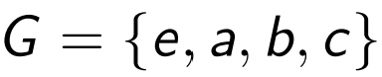
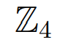
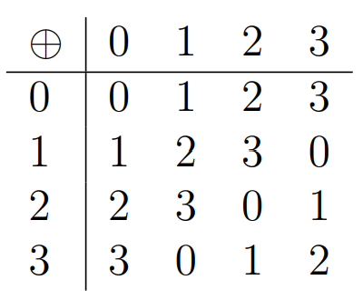
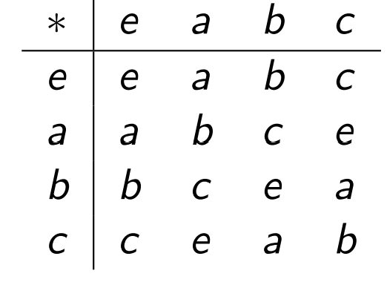
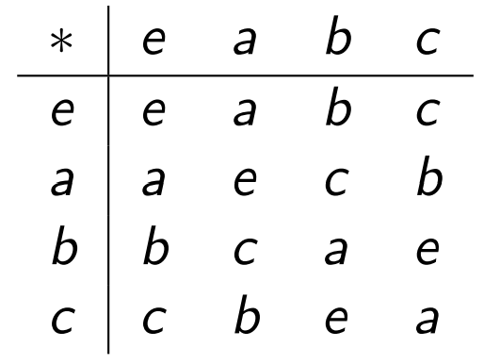
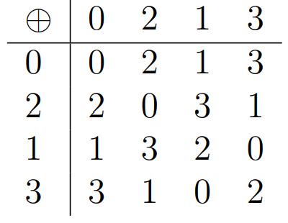
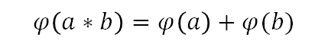
Structure preserving mappings
$$φ\left(a∗b\right)=φ\left(a\right)+φ(b)$$
$$φ$$
$$φ$$

Slide 28
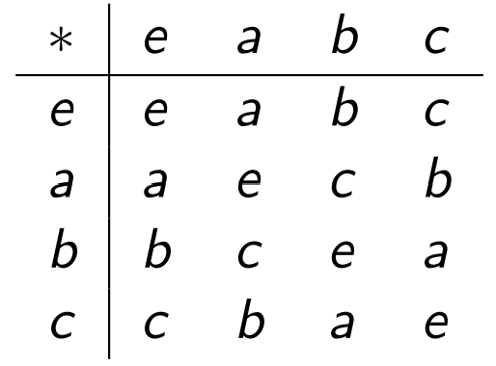
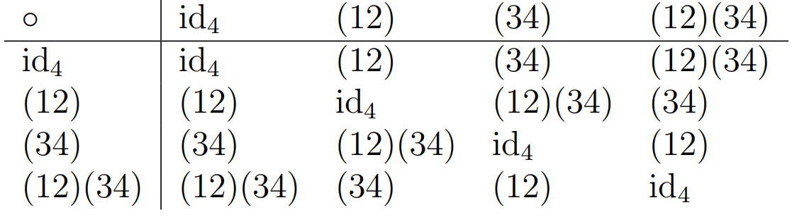
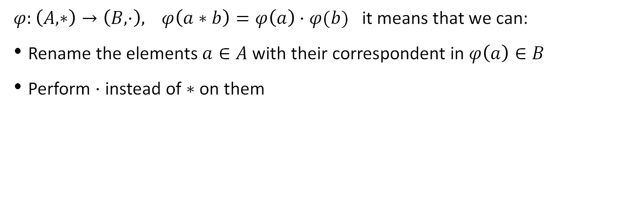
Structure preserving mappings
$φ:\left(A,∗\right)→\left(B,⋅\right), φ\left(a∗b\right)=φ\left(a\right)⋅φ(b)$ it means that we can:
Rename the elements $a∈A$ with their correspondent in $φ\left(a\right)∈B$
Perform $⋅$ instead of $∗$ on them
$$φ$$

Slide 29
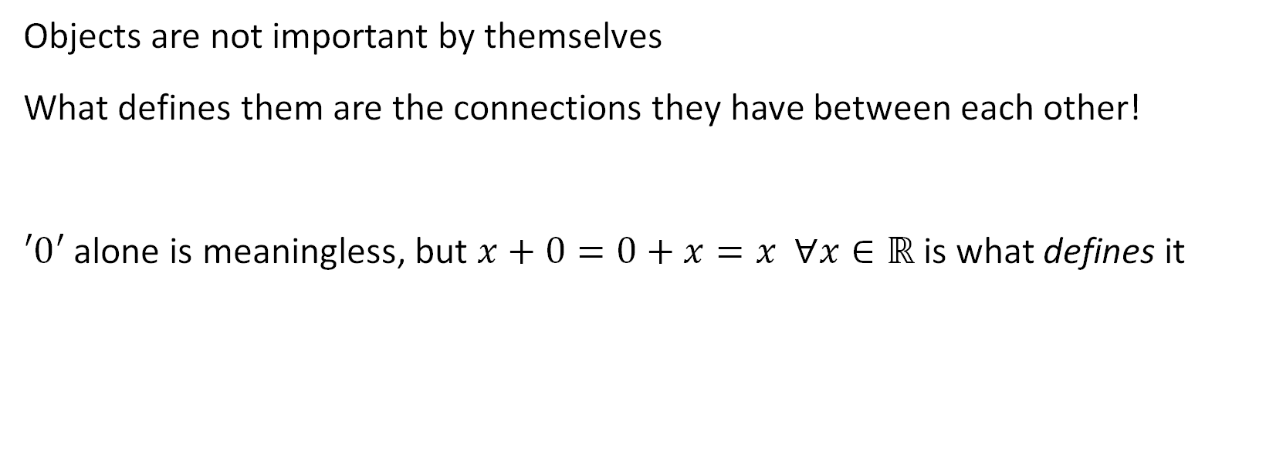
Morphisms is all you need!
Objects are not important by themselves
What defines them are the connections they have between each other!
$′0′$ alone is meaningless, but $x+0=0+x=x ∀x∈ℝ$ is what defines it

Slide 30
Word embeddings
Transform words into vectors

Slide 31
Word representations
How to represent a word?
One hot encoding is:
Sparse and inefficient
Expensive
No semantic information
Other more meaningful and tractable ways?
{Red, Blue, Green}
One-Hot encoding
Red =
Blue =
Green =

Slide 32
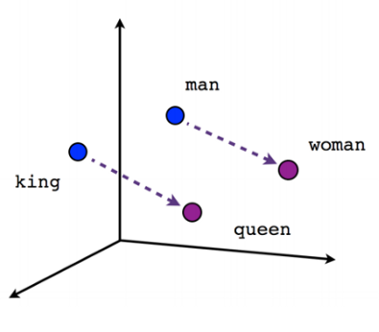
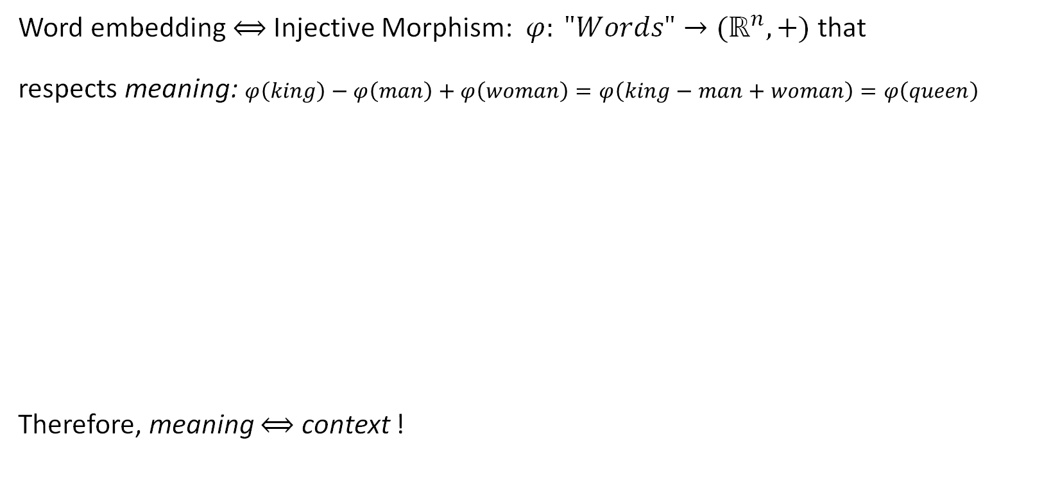
What are word embeddings
Word embedding $⟺$ Injective Morphism: $φ: "Words"→{(ℝ}^{n},+)$ that
respects meaning: $φ\left(king\right)−φ\left(man\right)+φ\left(woman\right)=φ\left(king−man+woman\right)=φ\left(queen\right)$
Therefore, meaning $⟺$ context !
Similar meanings correspond to similar vector representations,
where similar means that the two words are used in similar contexts

Slide 33
Meaning and context
We define the context of a word by its sorrounding window
Consider a window of size 4 and the sentence
…government debt problems turning into banking crises as…
The meaning of the word:
problems will be {government, debt, turning, into}
banking will be {turning, into, crises, as}
If our dictionary is {government, debt, problems, turning, into, banking, crises, as}:
banking
context

Slide 34
Fully-Connected Feed-Forward Neural network
0
h_{1,1}
.
.
.
.
.
.
.
.
.
h_{p,1}
1
. . . .
Cat
1
h_{1,2}
h_{p,2}
1
. . . .
Dog
Pet
.
.
.
.
.
.
.
.
.
.
.
.
One-Hot encoding
0
h_{1,K}
h_{P,L}
0
. . . .
Zimbabwe
Input Word
Dense Hidden Layer 1
(K x 1)
Dense Hidden Layer P
(L x 1)
Target
Context
Input Layer
size: (N x 1)
N=length of dictionary
Notes:
Traditional Neural Networks are not efficient for image processing because:
We would need to learn a different-sized weight matrix W for every size of the input image. (for an image of size 9x9 with a convolutional layer with 7 neurons a fully connected feed-forward neural network would need 9x9x7x7=3969 connections, whereas a CNN with only one kernel -> 3x3).
The weight matrix would be massively memory inefficient;
They do not exhibit translation invariance;

Slide 35
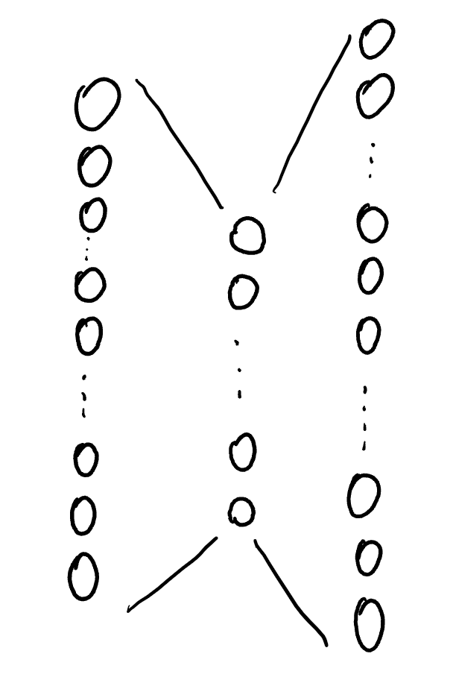




Word2vec idea: skipgram
Predicts the context given a specific word as input
(Fully connected) neural network:
Idea:
For the NN to do a good job in predicting the context, it must have learnt something in the middle (latent space): a weight matrix
Embedding
cat
car
dog
pet
Goal:
The embedding is smaller than the input/output. The columns of the weight matrix become the representations of the words!
Input
Output
One hot encoding
parrot
Zimbabwe

Slide 36
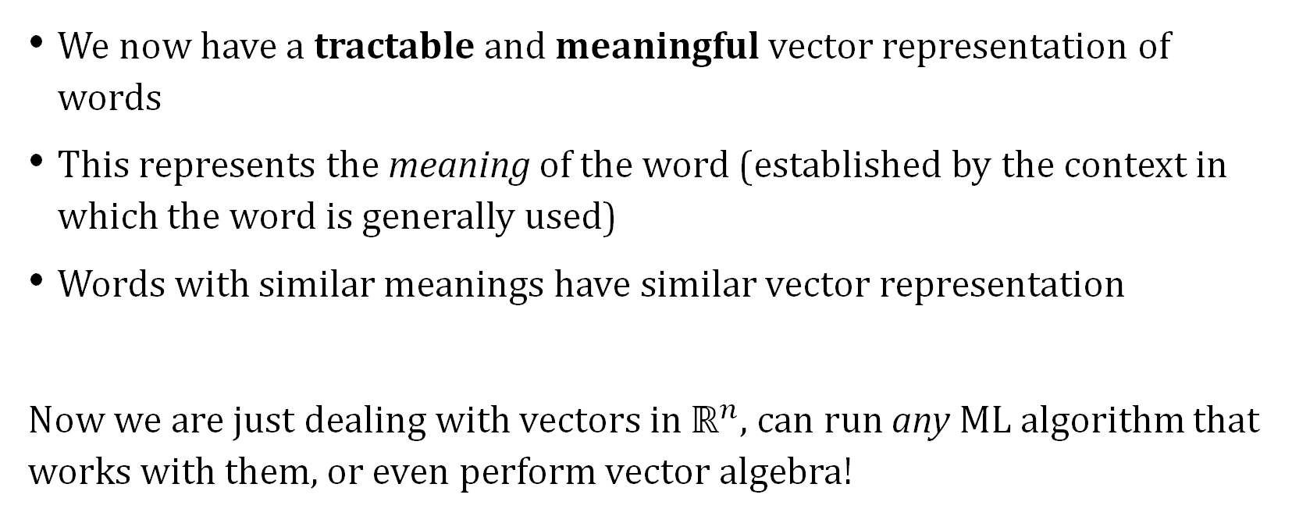
What now?
We now have a tractable and meaningful vector representation of words
This represents the meaning of the word (established by the context in which the word is generally used)
Words with similar meanings have similar vector representation
Now we are just dealing with vectors in $ℝ^{n}$, can run any ML algorithm that works with them, or even perform vector algebra!

